Slide 1
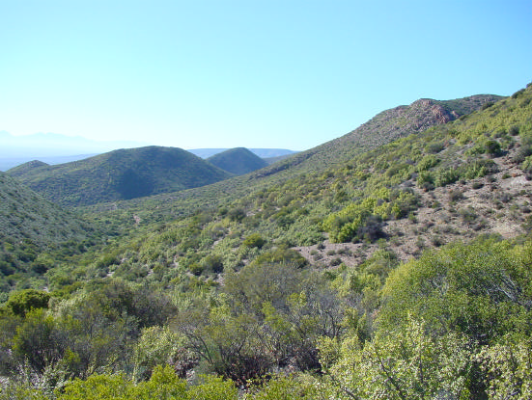
Very High Resolution Remote Sensing of Spekboom Canopy Cover
Dugal Harris¹
Jan Vlok²
Adriaan Van Niekerk³
Department of Geography & Environmental Studies, Stellenbosch University
Research Associate, Nelson Mandela Metropolitan University
Centre for Geographical Analysis, Stellenbosch University
[Source: J. Vlok]
Notes:
Doing masters by research
Avn supervisor
Jan Vlok botanist lot of exp in my study area
0:25

Slide 2

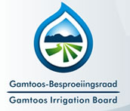




With thanks to
Gamtoos Irrigation Board via the Working for Water Programme for the Department of Environmental Affairs
National Research Foundation
Notes:
Start with ack
GIB (internship) funding
Help from many other ppl esp in sourcing the imagery
Collaborating Jan Vlok botanist expertise in my study area, does some work in field of spekboom restoration
My supervisor
0:15

Slide 3
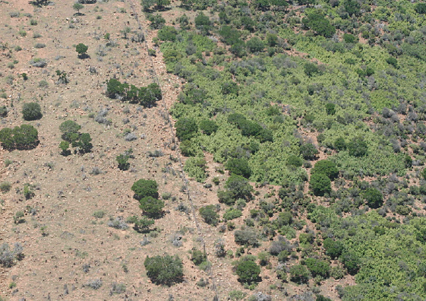
Background
Spekboom is an important species in the Subtropical Thicket biome. This biome has been degraded by overgrazing (Mills et al., 2005).
Restoration of degraded Subtropical Thicket through planting of Spekboom has a number of benefits (Mills and Cowling, 2006).
Spekboom canopy cover maps are needed to help select and monitor restoration sites.
Very high resolution (VHR) imagery is required for distinguishing small clumps of Spekboom and for mapping small restoration sites.
Restoration is planned for large regions.
[Source: M. Powell]
Notes:
Some background on motivation for my research.
Spekboom thicket has been irreversibly degraded by overgrazing throughout its range E Cape and Little Karoo FENCELINE CONTRAST!!!
Active restoration has number of benefits, spekboom acts as nurse plant creates fertile env for other plants to re-est in
Very effective at absorbing CO2, potentially gen income through trading cc’s, improves soil quality, water retention, gen employment
I imagine ppl are quite familiar with situation of spekboom being degraded & lot of interest in restoration.
Canopy cover is a first step towards biomass est from RS
1:10000 translates to ~1m pixel res i.e. VHR imagery
Canopy cover maps currently made manually
2:10
[Spekboom is very effective at storing carbon compared to other arid region vegetation (Mills et al. 2005).
Spekboom restoration can be funded by trading carbon credits on the international carbon market (Marais, Cowling & Powell 2009).
Restoration helps provide ecosystem services and employment in impoverished areas (Mills & Cowling 2006).
Restoration research and pilot studies are underway.]
Monitoring currently done manually by expert. Subjective, expensive over large areas.

Slide 4
Objectives
Perform a field study to establish reference sites with canopy cover ground truth.
Acquire and calibrate VHR aerial imagery from National Geo-spatial Information (NGI).
Develop a classifier that distinguishes Spekboom from surrounding vegetation & determine Spekboom canopy cover from the classifier output.
Notes:
In choosing project I wanted something of practical relevance and use.
Suggested to me by Jan Vlok.
NGI only practical option, other ppl produce high res imagery but v expensive.
Too much to cover in one presentation, focus on calibration & leaving out a lot of detail in development of classification
0:50
Academically some aspects of problem make it quite interesting. i.e.
Speak a bit of rationale
1.40

Slide 5
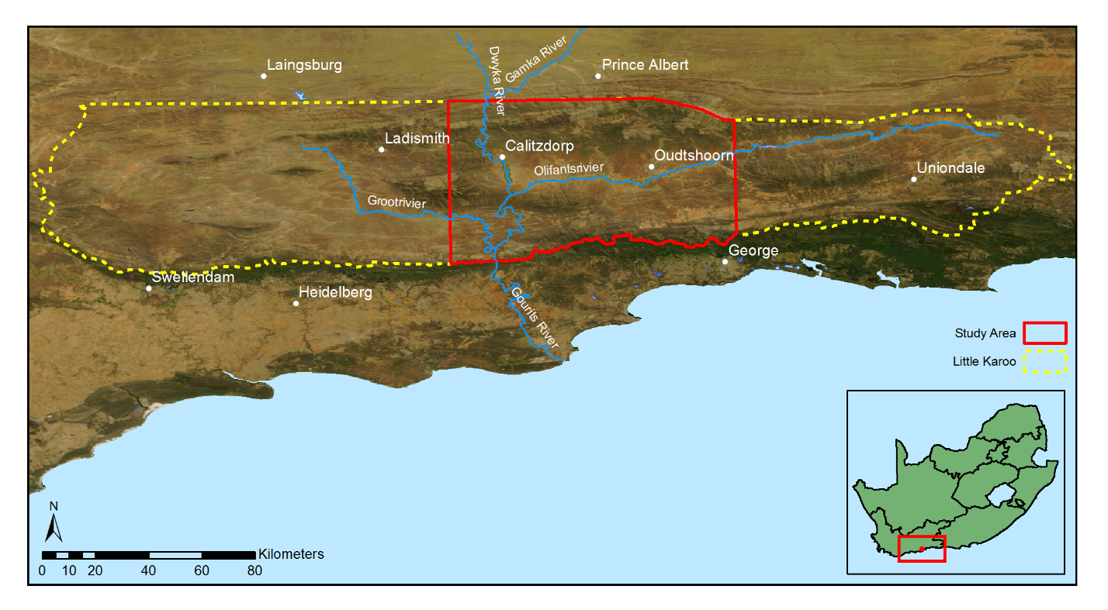
Study Area
Subtropical thicket makes up 35% of the Little Karoo of which roughly 90% is degraded.
Notes:
Recently have reduced study area as working with imagery for whole of study area was time consuming – give figures – 1 job of calibrated imagery = 400GB
Not practical to test methods on such a large volume of data
Reduced area still presents challenging calibration/classification problem. Methods developed for reduced area will still be applicable to larger area.
0:30
1:00
1.45

Slide 6
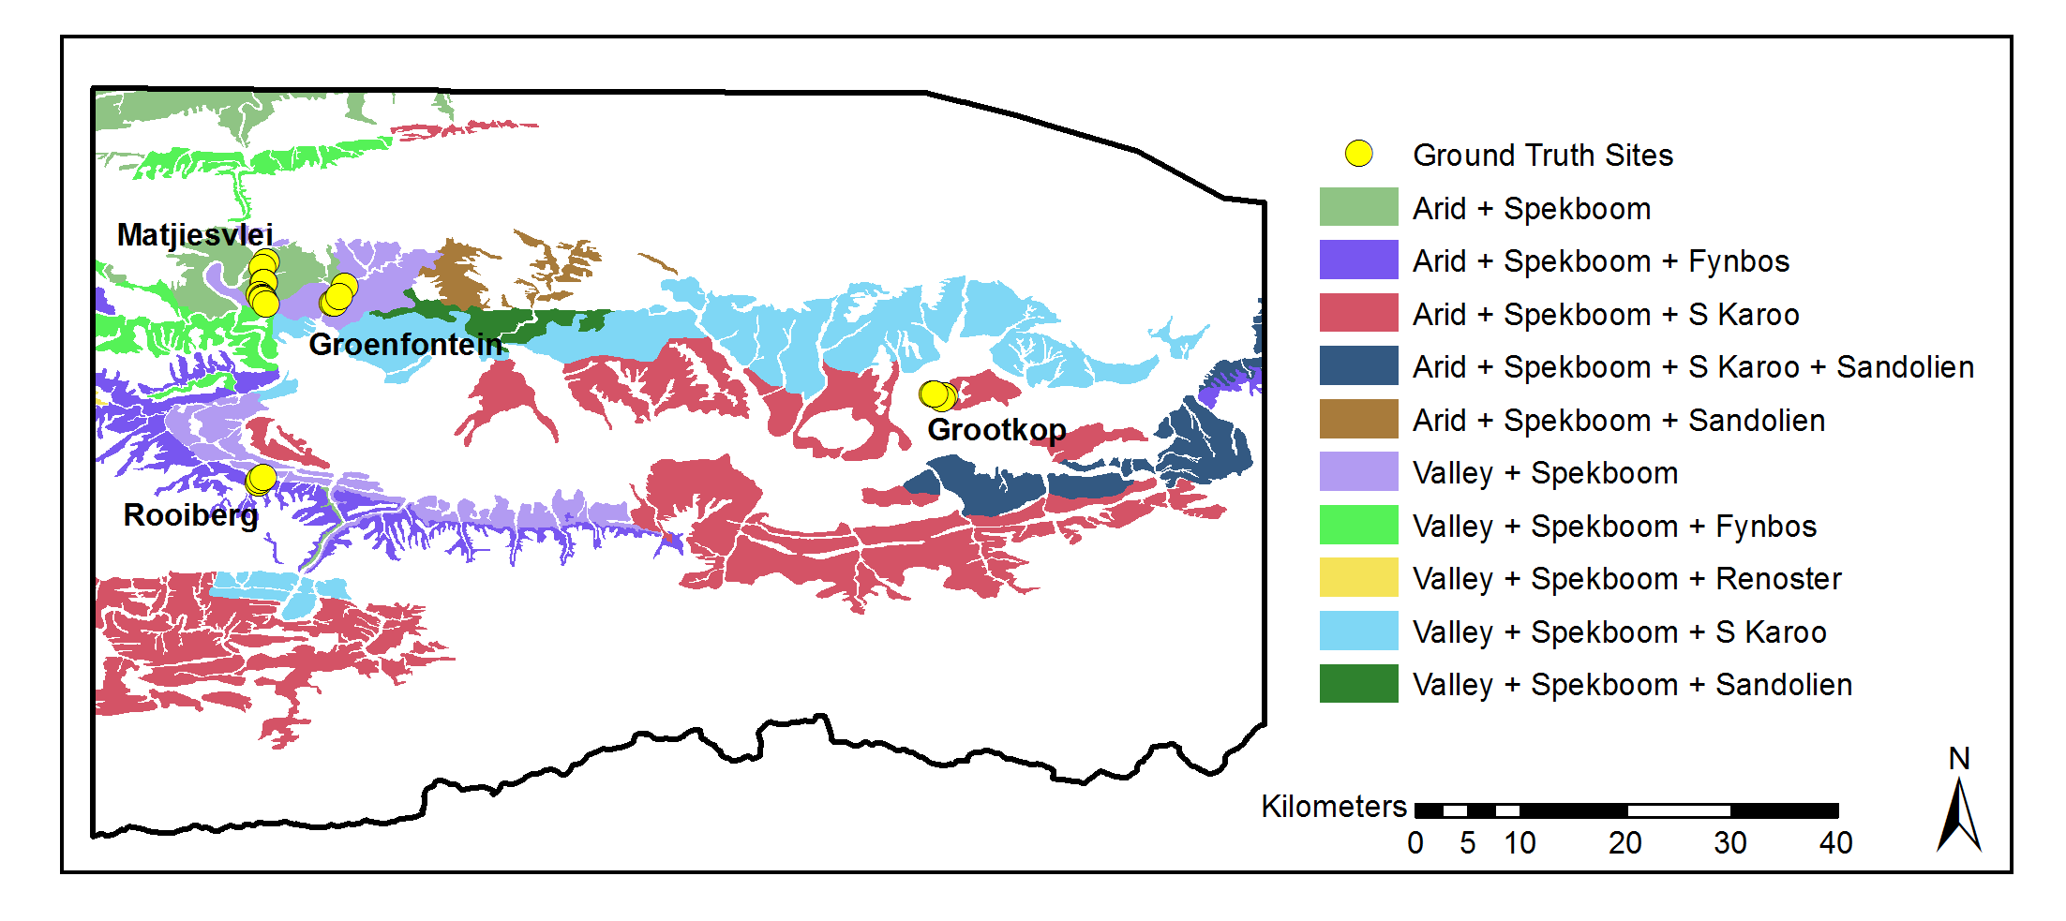
Study Area
[Source: (Vlok et al., 2005)]
Related studies have been performed in the area which provide useful ancillary data.
Area was chosen to incorporate as much variation as possible.
Notes:
9 of 10 habitat types
Degradation mapping study at much coarser res + jv’s veg map
It consists of four different aerial survey jobs flown at different times and thus still poses a challenging calibration problem. 2000 individual images.
*** It also includes examples of all the different biomes and nine of the ten habitat types supporting Spekboom
0:50
0:40
0:55
1.45

Slide 7
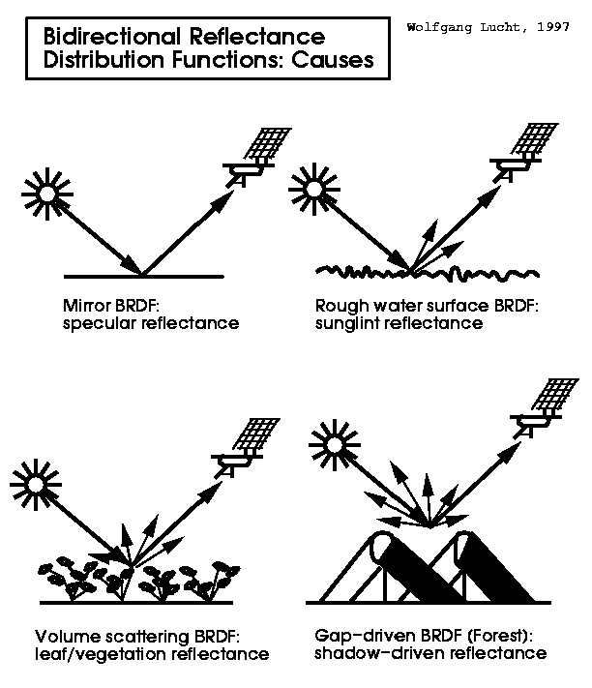
Radiometric Correction
Atmospheric influences, bidirectional reflectance distribution function (BRDF) effects and sensor variations all contribute to radiometric variations in the imagery.
These variations need to be reduced to map canopy cover over a large region and at repeated time intervals. (Markelin et al., 2012)
Existing radiometric correction methods for large aerial mosaics are complex and computationally intensive (Chandelier and Martinoty, 2009; Collings et al., 2011; López et al., 2011) .
A straightforward method for coarse resolution surface reflectance homogenisation of aerial imagery was developed.
The method uses a collocated and concurrent satellite surface reflectance image as a reference.
Notes:
1:45
First step was to obtain calibrated imagery. NGI free but no radiometric calibration which is req for quantitative rs. Radiometric = colour / spectral content. For quantitative rs we want to reduce spatial / temporal variations as far as possible. 4 survey jobs of ~ 2000 images in total
Existing techniques for mosaics of aerial imagery… (aerial imagery has special needs)
Radiometric means spectral content or colour.
Recurring theme in literature around problems, extending methods over space and time which is partially calibration issue.
Effects that result in radiometric variation are phsyically complex and difficult to simulate and quantify.
Absolute meas not strictly necessary, so long as consistent can be relative but absolute useful for combining / comparing data, consistency over time.
Also req’d for my research, ngi economical but uncalibrated. Allows fusion w
The high spatial resolution of these images enables analyses on a finer spatial scale than most satellite based platforms can provide and consequently opens up the exploitation of information such as texture, object-based features and unmixed pixel spectra that is not available or less effective in lower resolution images

Slide 8
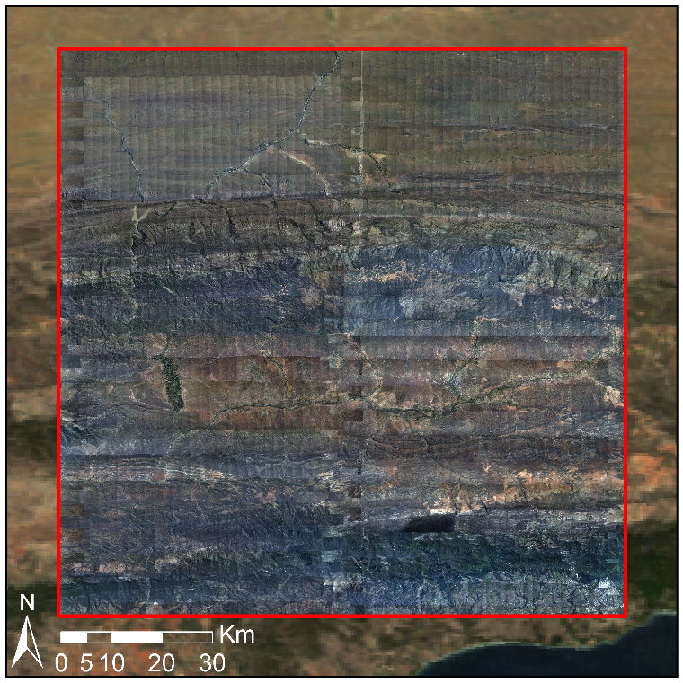
Radiometric Correction: Results
Raw/ Uncorrected Mosaic
Notes:
:45
:30
These are results of our method.
Visual ind of eff
Seamlines & gradients due to brdf, atmospheric effects

Slide 9
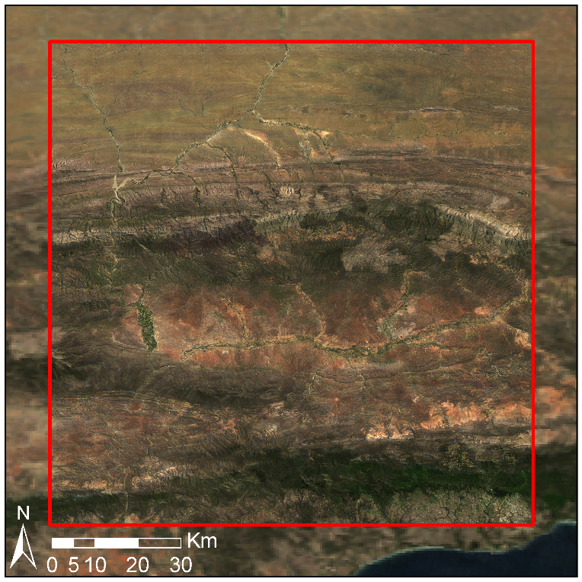
Radiometric Correction: Results
Corrected Mosaic
Notes:
:15
Seamlines removed

Slide 10
Classification: Methodology
Per-pixel approach was found to be adequate and avoided the complexities and computation time associated with object based approaches.
Three classes (Spekboom, Tree, Background) were used - to improve classifier descriptive complexity.
Canopy cover found as portion of pixels classified as Spekboom over an area of interest.
46 spectral, textural and vegetation index features were evaluated.
A method of selecting features in the presence of redundancy was developed and used to select a reduced set of 6 informative features.
A number of classifiers (KNN, normal Bayes, SVM, random forest, decision tree) were evaluated.
Computation time was considered when choosing features and classifier.
Notes:
2:00
Departments trimble device
Representative (degradation, geology, habitat)
1:30

Slide 11
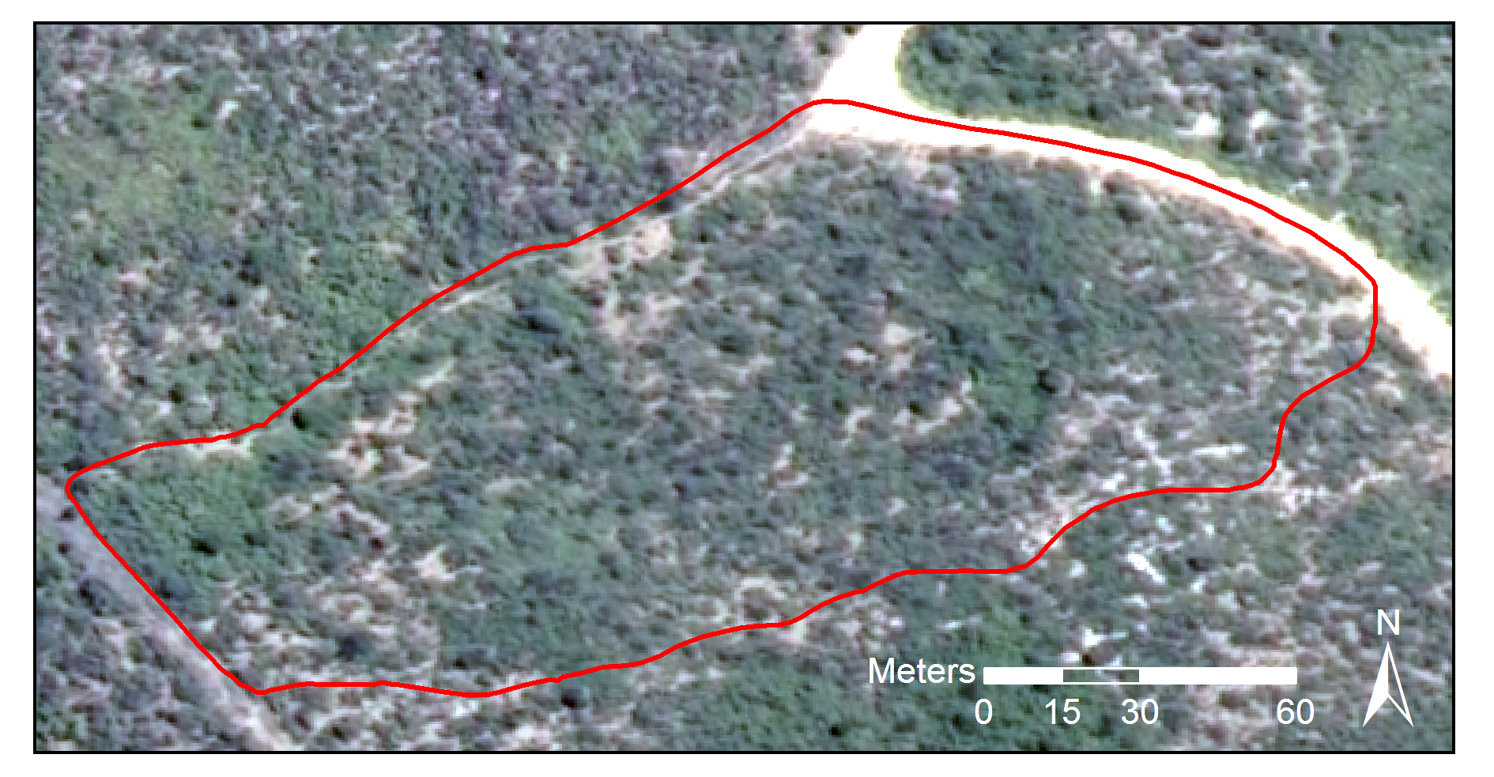
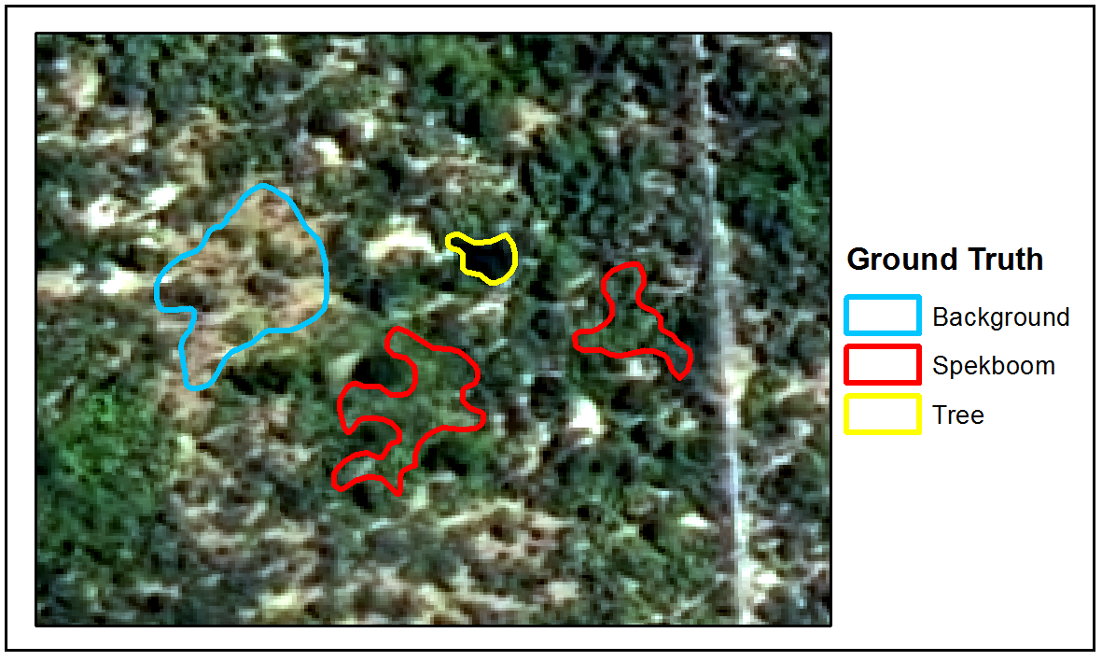
Classification: Data
Label
In situ canopy cover data
20 sites of roughly a hectare each were selected to encompass variation in geology, biome and level of degradation.
Boundary polygons were recorded with a DGPS device.
Estimates of canopy cover inside the polygons were established visually.
Used for evaluating accuracy of canopy cover estimates.
Labelled pixel data
Established by creating and hand-labelling polygons in the imagery.
Used for training and validation of per-pixel classifier.
Notes:
Departments trimble device
Representative (degradation, geology, habitat)
1:00

Slide 12
Classification: Results
6 informative features were selected (NDVI, pc1, EntropyPc1, gN, bN and rc2)
Decision tree chosen as it achieved best results on in situ canopy cover data and was the second fastest.
A mean absolute canopy cover error of 6% was obtained over 20 ground truth sites.
Overall the performance was remarkably good although some sites did prove problematic.
Area | Num. | Ground Truth (%) | Classifier (%)
Groenfontein | 1 | 0.00 | 0.07
 | 2 | 4.00 | 0.47
 | 3 | 10.00 | 8.21
 | 4 | 25.00 | 17.44
Matjiesvlei | 1a | 6.00 | 7.21
 | 1b | 22.50 | 31.37
 | 2 | 70.00 | 67.38
 | 3 | 85.00 | 73.12
 | 4 | 65.00 | 70.34
 | 5 | 37.50 | 35.95
 | 6 | 17.50 | 12.01
 | 7 | 15.00 | 25.74
 | 8 | 2.00 | 5.42
Rooiberg | 1 | 20.00 | 6.03
 | 2 | 11.00 | 1.03
 | 3 | 0.00 | 0.00
Grootkop | 1 | 22.50 | 8.05
 | 2 | 0.50 | 0.22
 | 3 | 42.50 | 34.38
 | 4 | 77.50 | 71.27
MAE (SAE)ª |  |  | 5.85% (4.65%)
 | Background | Spekboom | Total | PA (%)ª
Background | 30103 | 514 | 30617 | 98.32
Spekboom | 1491 | 25769 | 27260 | 94.53
Total | 31594 | 26283 | 57877
CA (%)ª | 95.28 | 98.04
Kappa | 0.93
Overall Error (%) | 3.57
Two –class confusion matrix
Canopy cover estimation accuracy
Notes:
Performance on image ground truth extremely good – 3.57% overall error.
Performance on field ground truth good – 5.85%. Tendency to overest in densely veg areas and underest in more arid / degraded areas. But accurate and useful nevertheless.
Clfr beats expert estimates from images. All things considered, I’m very happy with these results.
1:30
Some error present in ground truth itself as was an estimate,
Difference in error suggests image ground truth not that repr of field ground truth. Not v surprising as image areas were chosen where certainty as to class which means more challenging eg’s omitted .

Slide 13
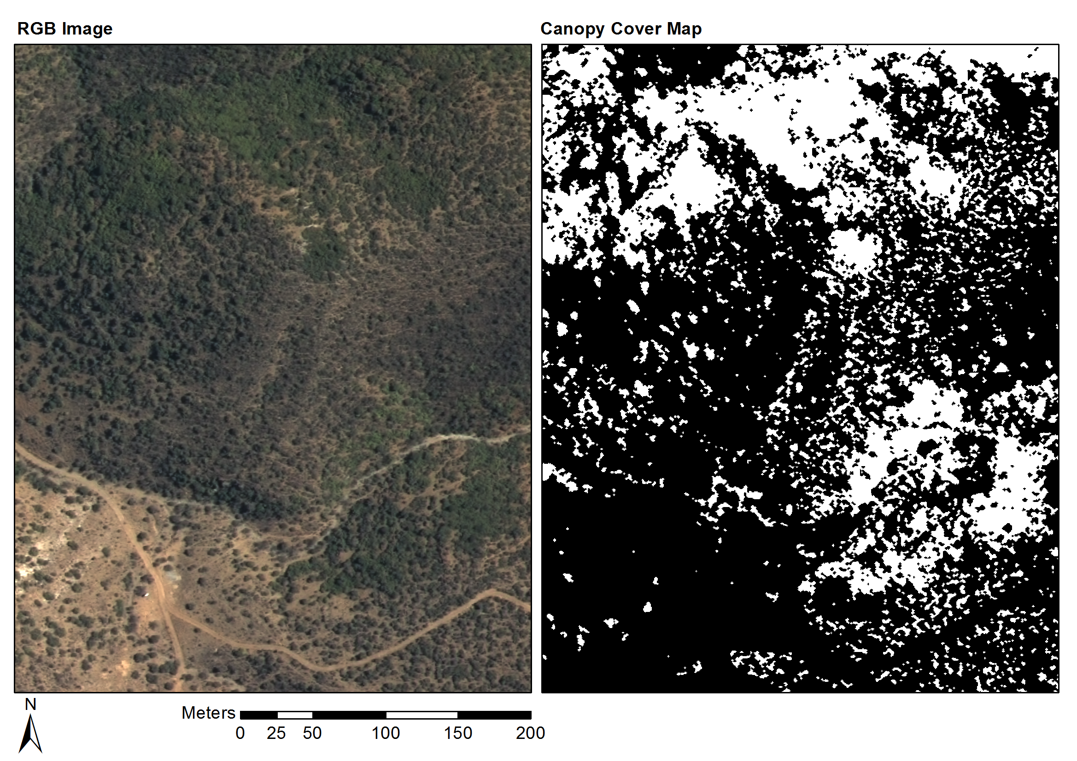
Classification: Results
Notes:
Figure show example results.
RH images display prob that a pix is Spekboom (white = 100% prob, black 0%). Have checked with Jan Vlok that these images are Spekboom thicket
60
Groenfontein, shale, moderate – sever degradation

Slide 14
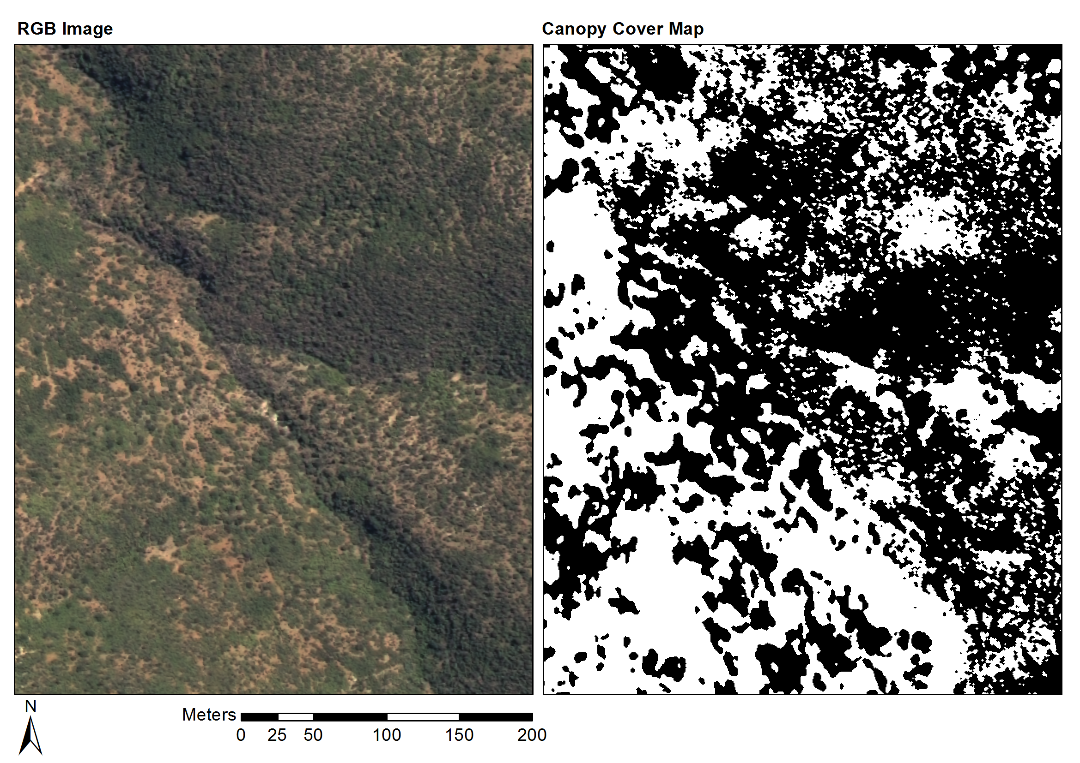
Classification: Results
Notes:
Matjiesvlei, shale, pristine

Slide 15
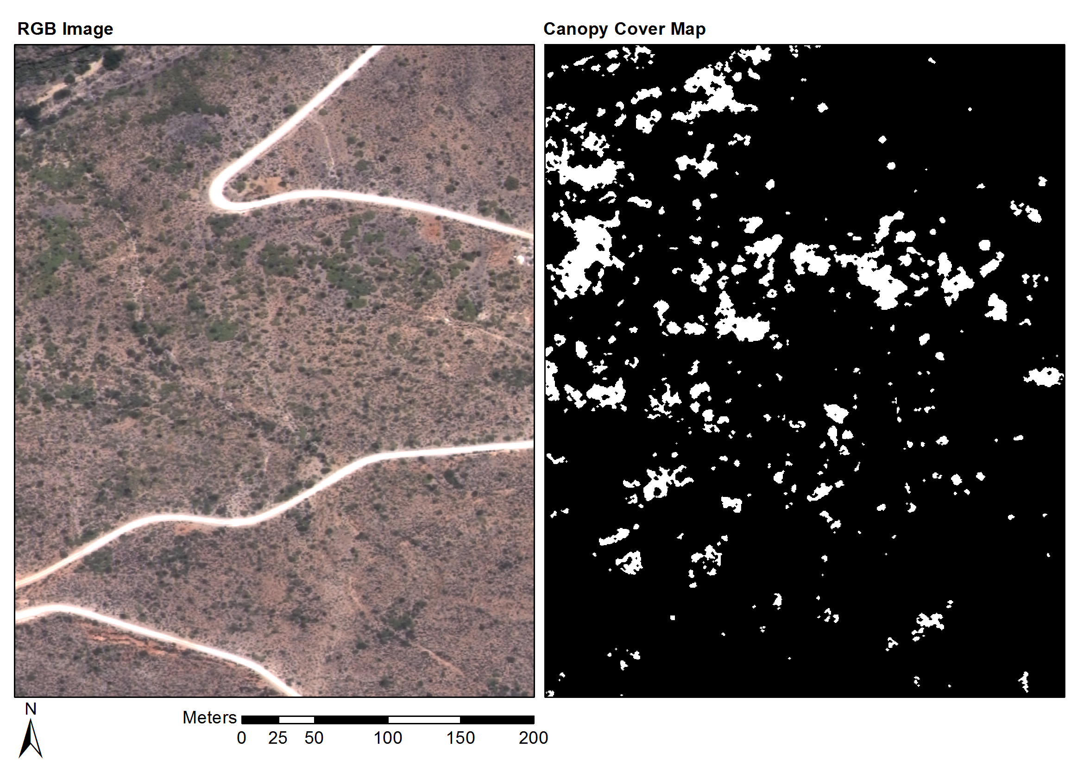
Classification: Results
Notes:
Fynbos mosaic area, prev farm quite degraded, sandstone
Figure show example results. RH images display prob that a pix is Spekboom (white = 100% prob, black 0%). Have checked with Jan Vlok that these images are Spekboom thicket
0:50

Slide 16
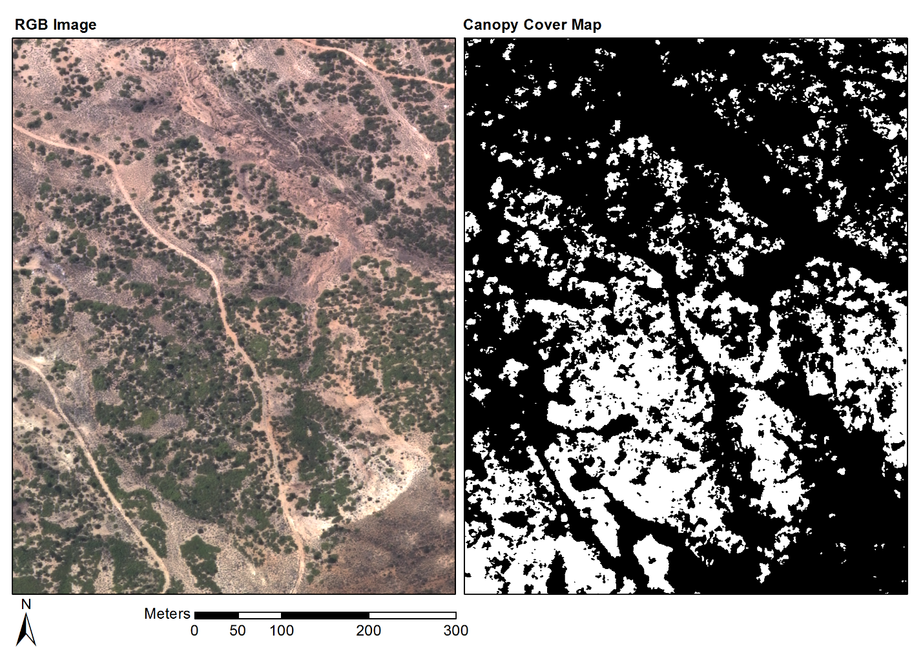
Classification: Results
Notes:
Grootkop. Succ. Karoo mosaic. Close to Oudtshoorn, parts quite degraded, . Enon conglomerate

Slide 17
References
Chandelier, L., Martinoty, G., 2009. A radiometric aerial triangulation for the equalization of digital aerial images and orthoimages. Photogrammetric Engineering & Remote Sensing 75, 193–200.
Collings, S., Caccetta, P., Campbell, N., Wu, X., 2011. Empirical models for radiometric calibration of digital aerial frame mosaics. IEEE Transactions on Geoscience and Remote Sensing 49, 2573–2588. doi:10.1109/TGRS.2011.2108301
López, D.H., García, B.F., Piqueras, J.G., Guillermo, V.A., 2011. An approach to the radiometric aerotriangulation of photogrammetric images. ISPRS Journal of Photogrammetry and Remote Sensing 66, 883–893. doi:10.1016/j.isprsjprs.2011.09.011
Mills, A.J., Cowling, R.M., 2006. Rate of carbon sequestration at two thicket restoration sites in the Eastern Cape, South Africa. Restoration Ecology 14, 38–49.
Mills AJ, Cowling RM, Fey M, Kerley G, Donaldson J, Sigwela A, Skowno A & Rundel P 2005. Effects of goat pastoralism on ecosystem carbon storage in semiarid thicket , Eastern Cape , South Africa. Austral Ecology 30: 797-804.
Vlok J, Cowling RM & Wolf T 2005. A vegetation map for the Little Karoo. Unpublished maps and report for a SKEP project supported by CEPF grant no 1064410304.
Notes:
Mostly new calib references

Slide 18
Questions?

